Slide 1
Introduction to functional mathematics

Slide 2
Outline
Math for programmers

Slide 3
Math for programmers
What type of Mathematics is most important for Coding and Programming:
Linear Algebra: is fundamental for programmers, especially data scientists, because machine learning frequently uses matrices to represent the data being analyzed.
Terms within linear algebra like linear equations, linear transformation, vector, matrix, transpose, inverse of a matrix, and identity matrix are all important for programmers to understand.
Boolean Algebra: deals with how computer circuits operate. You’ll be using logics like AND, OR, NOT, XOR, and XNOR to build code.
Cryptography: is the science of secret writing. The principle behind cryptography is that only the intended recipient of a communication will be able to read it. Cryptography is used in programming to create privacy and security by requiring users to confirm their identity or allowing users to securely exchange messages back and forth.

Slide 4
Mathematical Induction: is the foundation of any recursive programming. Recursion is a programming approach in which a function or algorithm repeatedly calls itself until a certain condition is met.
Probability and Statistics: Algorithms within machine learning use models of underlying probability distribution.
Calculus: To optimize a machine learning algorithm, multivariate calculus is used. Calculus is also used in simulation-based programs when objects have to interact with each other.
Graph Theory: Proofs and theorems of graph theory help programmers create navigable code and also navigate through programming more easily.

Slide 5
topic 1: BASIC algebra

Slide 6
outline
Linear Equations
Quadratic Equations
Inequalities
Functions

Slide 7
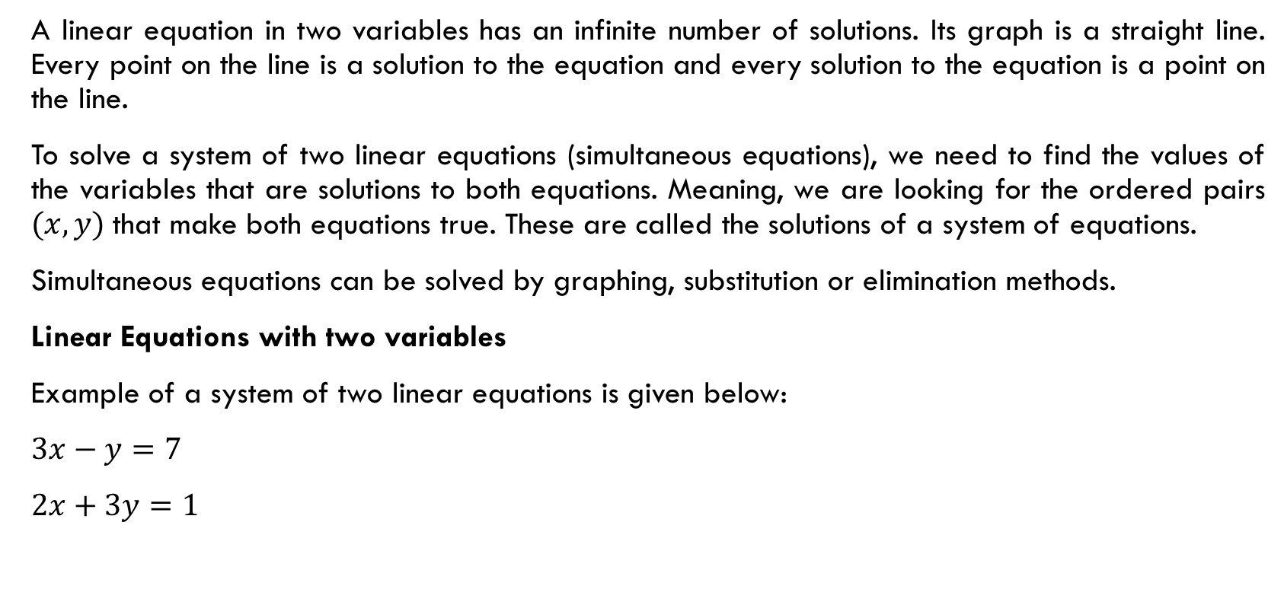
Linear equations
A linear equation in two variables has an infinite number of solutions. Its graph is a straight line. Every point on the line is a solution to the equation and every solution to the equation is a point on the line.
To solve a system of two linear equations (simultaneous equations), we need to find the values of the variables that are solutions to both equations. Meaning, we are looking for the ordered pairs $(x, y)$that make both equations true. These are called the solutions of a system of equations.
Simultaneous equations can be solved by graphing, substitution or elimination methods.
Linear Equations with two variables
Example of a system of two linear equations is given below:
$3x−y=7$
$2x+3y=1$

Slide 8

Example 1: Solve the following system of two linear equations by substitution / elimination methods:
1) $x−y=−12$
$x+y=−5$
2) $5x+4y=1$
$3x−6y=2$
Question 1: Solve the following system of two linear equations by substitution / elimination methods:
1) $2x+4y=−10$
$6x+3y=6$
2) $x+y=0$
$x+2y=−5$

Slide 9

Question 2: Solve the following system of linear equations?
$\frac{1}{2x}−\frac{1}{y}=−1$
$\frac{1}{x}+\frac{1}{2y}=8$
$\left(x≠0, y≠0\right)$
Solution:
Let $1/x = U$and $1/y = V$. The given equations become
$\frac{U}{2} – v = –1$⇒ $u –2v = –2$….(i)
$u + \frac{V}{2}=8$⇒ $2u + v = 16$ ….(ii)
Multiplying equation (ii) by 2 on both sides and adding (i) and (ii), we get
$(u + 4u) + (–2v + 2v) = –2 + 32$
⇒ $5u = 30$
⇒ $u = 6 and V=$4 ⇒ $x =\frac{1}{6} and y = \frac{1}{4}$

Slide 10

Question 3: Solve the following system of linear equations?
$\frac{1}{x}−\frac{4}{y}=2$
$\frac{1}{x}+\frac{3}{y}=9$
Solution:
$x =\frac{1}{6}$
$y=1$

Slide 11
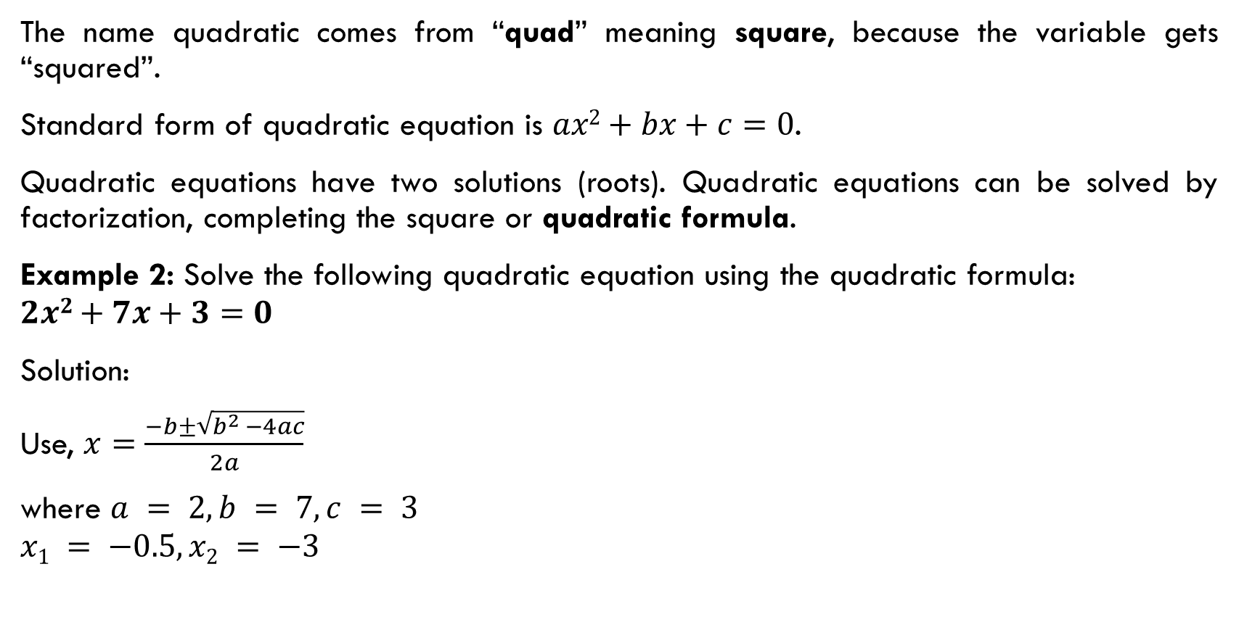
Quadratic equations
The name quadratic comes from “quad” meaning square, because the variable gets “squared”.
Standard form of quadratic equation is $ax2+bx+c=0$.
Quadratic equations have two solutions (roots). Quadratic equations can be solved by factorization, completing the square or quadratic formula.
Example 2: Solve the following quadratic equation using the quadratic formula:
$$2x2+7x+3=0$$
Solution:
Use, $x=\frac{−b±\sqrt{b^{2 }−4ac}}{2a}$
where $a = 2, b = 7, c = 3$
$$x1 = −0.5, x2 = −3$$

Slide 12
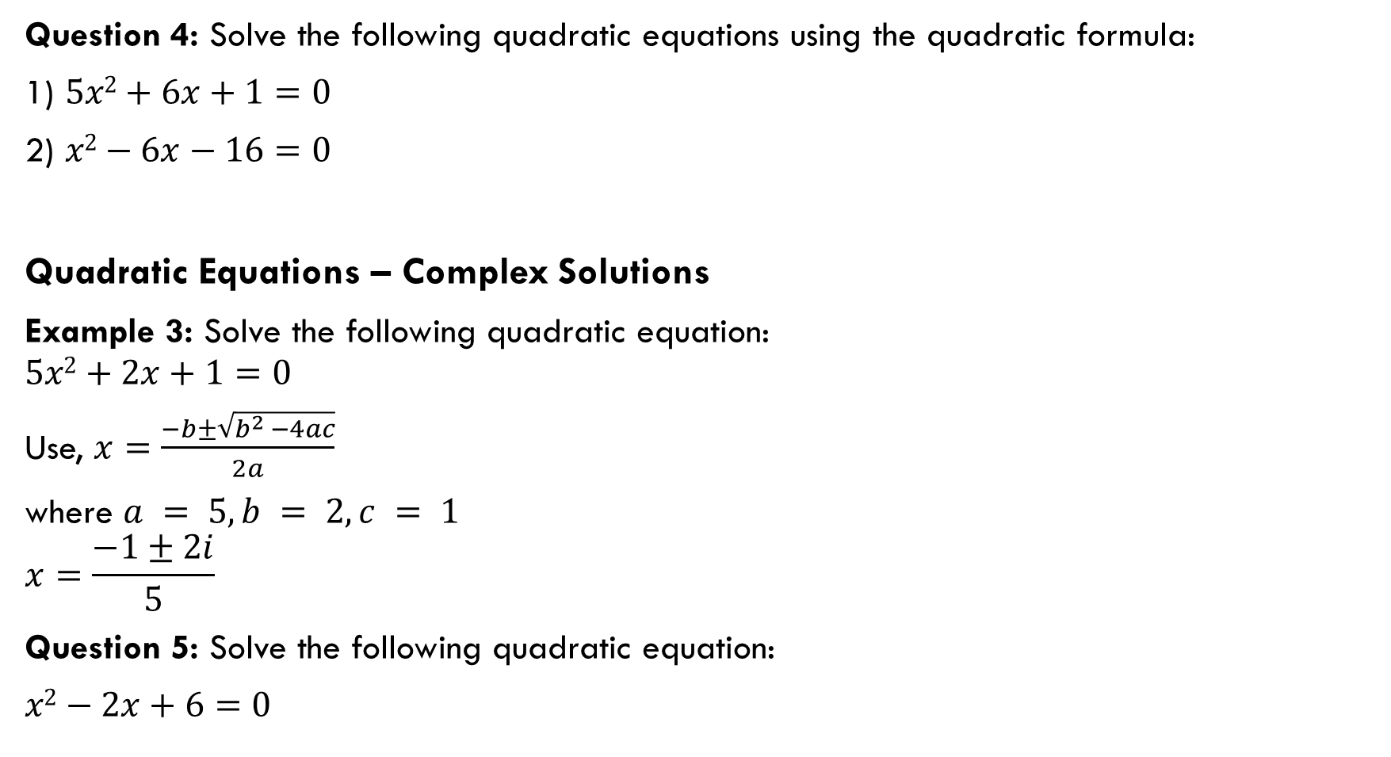
Question 4: Solve the following quadratic equations using the quadratic formula:
1) $5x2+6x+1=0$
2) $x2−6x−16=0$
Quadratic Equations – Complex Solutions
Example 3: Solve the following quadratic equation:
$$5x2+2x+1=0$$
Use, $x=\frac{−b±\sqrt{b^{2 }−4ac}}{2a}$
where $a = 5, b = 2, c = 1$
$$x=\frac{−1±2i}{5}$$
Question 5: Solve the following quadratic equation:
$x2−2x+6=0$

Slide 13
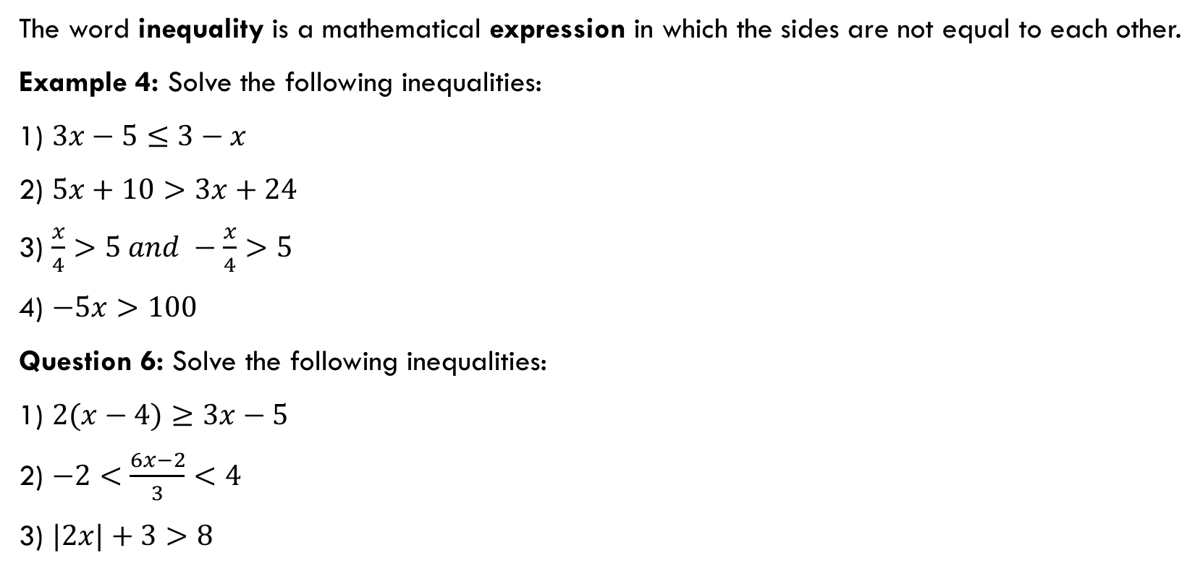
inequalities
The word inequality is a mathematical expression in which the sides are not equal to each other.
Example 4: Solve the following inequalities:
1) $3x−5≤3−x$
2) $5x+10>3x+24$
3) $\frac{x}{4}>5 and −\frac{x}{4}>5$
4) $−5x>100$
Question 6: Solve the following inequalities:
1) $2(x−4)≥3x−5$
2) $−2<\frac{6x−2}{3}<4$
3) $|2x|+3>8$

Slide 14
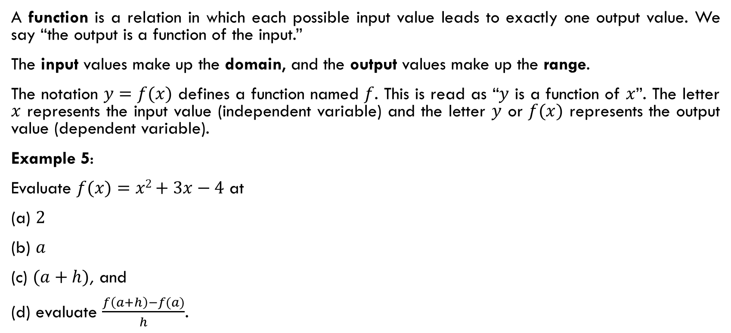
functions
A function is a relation in which each possible input value leads to exactly one output value. We say “the output is a function of the input.”
The input values make up the domain, and the output values make up the range.
The notation $y=f(x)$ defines a function named $f$. This is read as “$y$ is a function of $x$”. The letter $x$ represents the input value (independent variable) and the letter $y$ or $f(x)$ represents the output value (dependent variable).
Example 5:
Evaluate $f(x)=x2+3x−4$ at
(a) $2$
(b) $a$
(c) $(a+h)$, and
(d) evaluate $\frac{f\left(a+h\right)−f(a)}{h}$.

Slide 15
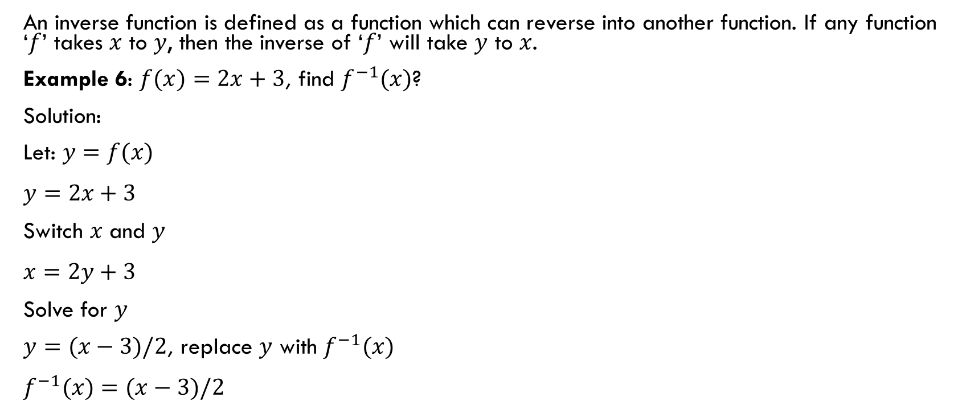
Inverse of a function
An inverse function is defined as a function which can reverse into another function. If any function ‘$f$’ takes $x$ to $y$, then the inverse of ‘$f$’ will take $y$ to $x$.
Example 6: $f(x)=2x+3$, find $f^{−1}(x)$?
Solution:
Let: $y=f(x)$
$y=2x+3$
Switch $x$ and $y$
$x=2y+3$
Solve for $y$
$y=(x−3)/2$, replace $y$ with $f^{−1}(x)$
$f^{−1}(x)=(x−3)/2$

Slide 16
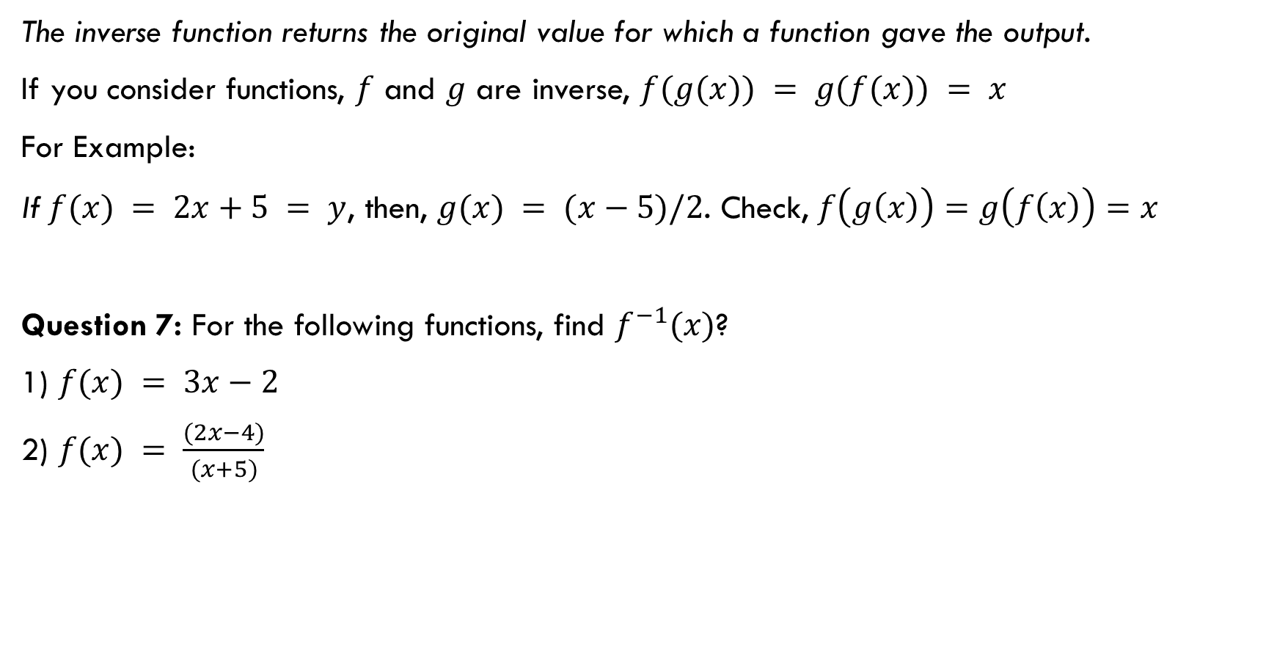
The inverse function returns the original value for which a function gave the output.
If you consider functions, $f$ and $g$ are inverse, $f(g(x)) = g(f(x)) = x$
For Example:
If$f(x) = 2x+5 = y$, then, $g(x) = (x−5)/2$. Check, $f\left(g\left(x\right)\right)=g\left(f\left(x\right)\right)=x$
Question 7: For the following functions, find $f^{−1}(x)$?
1) $f(x) = 3x−2$
2) $f(x) = \frac{(2x−4)}{(x+5)}$

Slide 17
Resource:
https://revelry.co/insights/development/doing-algebra-in-code/

